Slide 1
Automated platform for rapid multifunctional materials characterization under dynamic programmable environments
Eric Muckley, Ilia Ivanov
Abstract
Novel materials must be screened for stability and functionality under a broad range of ambient environmental conditions before they can be deployed in real-world applications. Multidimensionality of the environmental parameter space (temperature, pressure, humidity, gas/vapor composition) and common characterization modes (electrical, optical, gravimetric, viscoelastic) creates unique challenges for efficient data processing and experimental design. We developed an integrated computer-controlled system which enables simultaneous multi-sample screening of electrical, optical, gravimetric and viscoelastic properties of materials under programmable dynamic environments. Custom software performs on-the-fly data analysis and modeling, real-time iterative feedback for dynamic experimental settings, and rapid visualization of experimental results. The system reduces the time needed for researcher-directed experiment planning and data processing from hours to minutes, enabling high-throughput characterization of functionality and environmental response of a broad range of materials including oxides, nanotubes, two-dimensional materials, biomolecules, perovskites, polymers and ionic liquids. Here we demonstrate capabilities of the system, describe operational algorithms, and provide examples of high-quality multifunctional data acquired with minimal human intervention.

Slide 2
(a)
Experiment
Theory
In (a) color scheme need to have multifunctional characterization standing off the rest since we are talking about it in (b) and (c)
Multifunctional characterization in traditional workflow may need to be duplicated with offset to show that the workflow is only for a single functionality. To test other functionality, one must to replicate the same workflow but for different instrument
Computer-controlled multifunctional response workflow removes limitation of transitional workflow by giving full control of instruments, experimental conditions and parameters through real-time iterative feedback
High-throughput synthesis
Materials database
Simulation and modeling
Multifunctional characterization
(b)
(c)
Traditional workflow
Automated workflow
Human adjusts experimental settings
Computer adjusts experimental settings
Data acquisition
Data acquisition
Manual experiment planning
Real-time iterative feedback
Human processes and models data
Each material functionality
Computer processes and models data
Human interprets and presents data
Computer presents data

Slide 3
In (a) color scheme need to have multifunctional characterization standing off the rest since we are talking about it in (b) and (c)
Multifunctional characterization in traditional workflow may need to be duplicated with offset to show that the workflow is only for a single functionality. To test other functionality, one must to replicate the same workflow but for different instrument
Computer-controlled multifunctional response workflow removes limitation of transitional workflow by giving full control of instruments, experimental conditions and parameters through real-time iterative feedback
(a)
(b)
Traditional workflow
Automated workflow
Human adjusts experimental settings
Computer adjusts experimental settings
Data acquisition
Data acquisition
Manual experiment planning
Real-time iterative feedback
Human processes and models data
Each material functionality
Computer processes and models data
Human interprets and presents data
Computer presents data

Slide 4
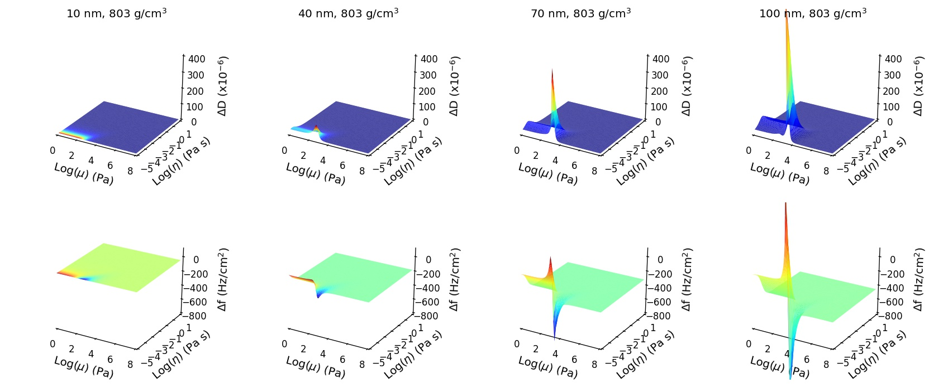
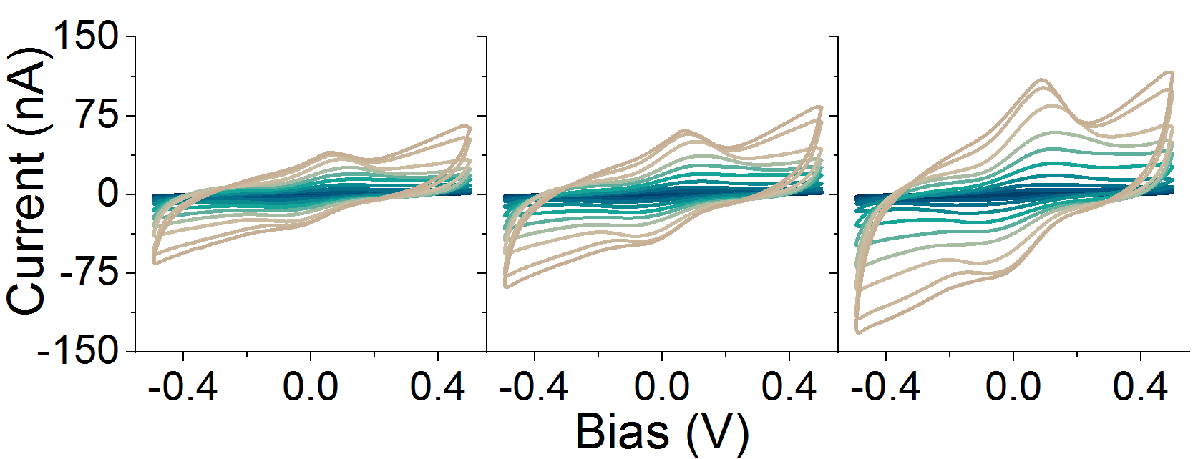
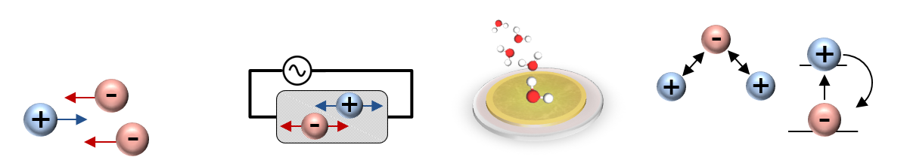
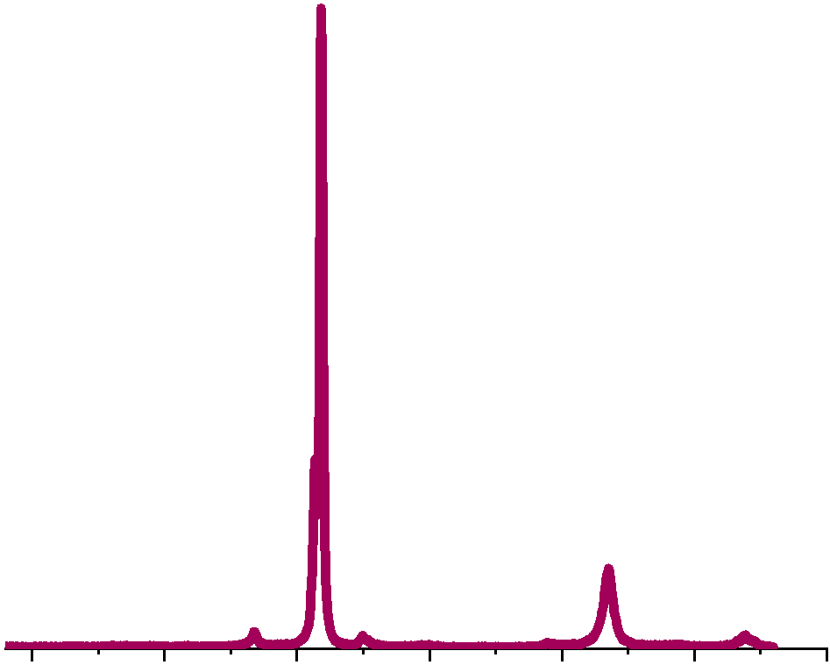
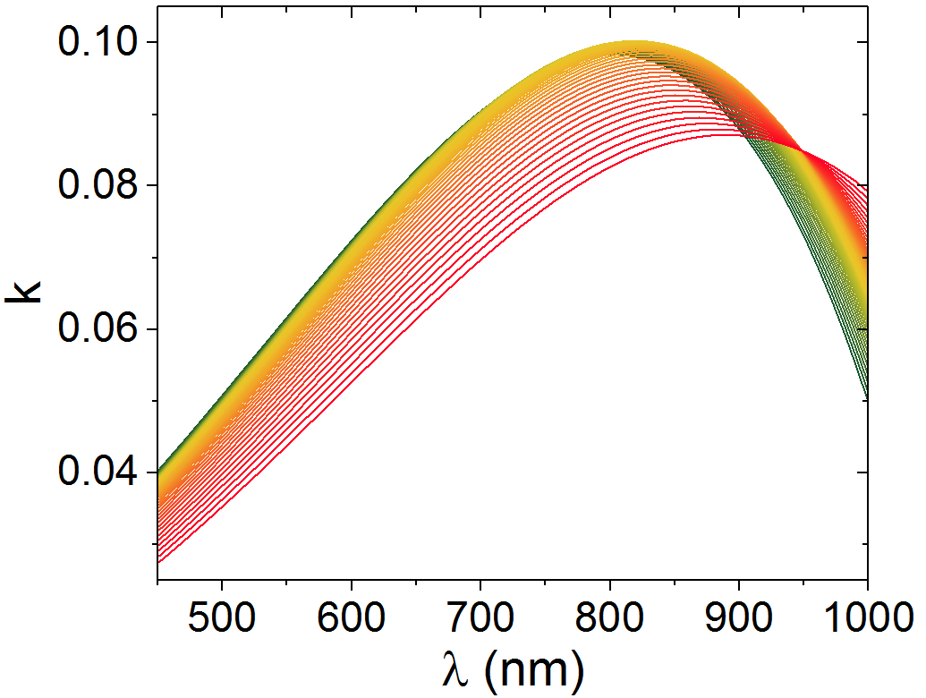
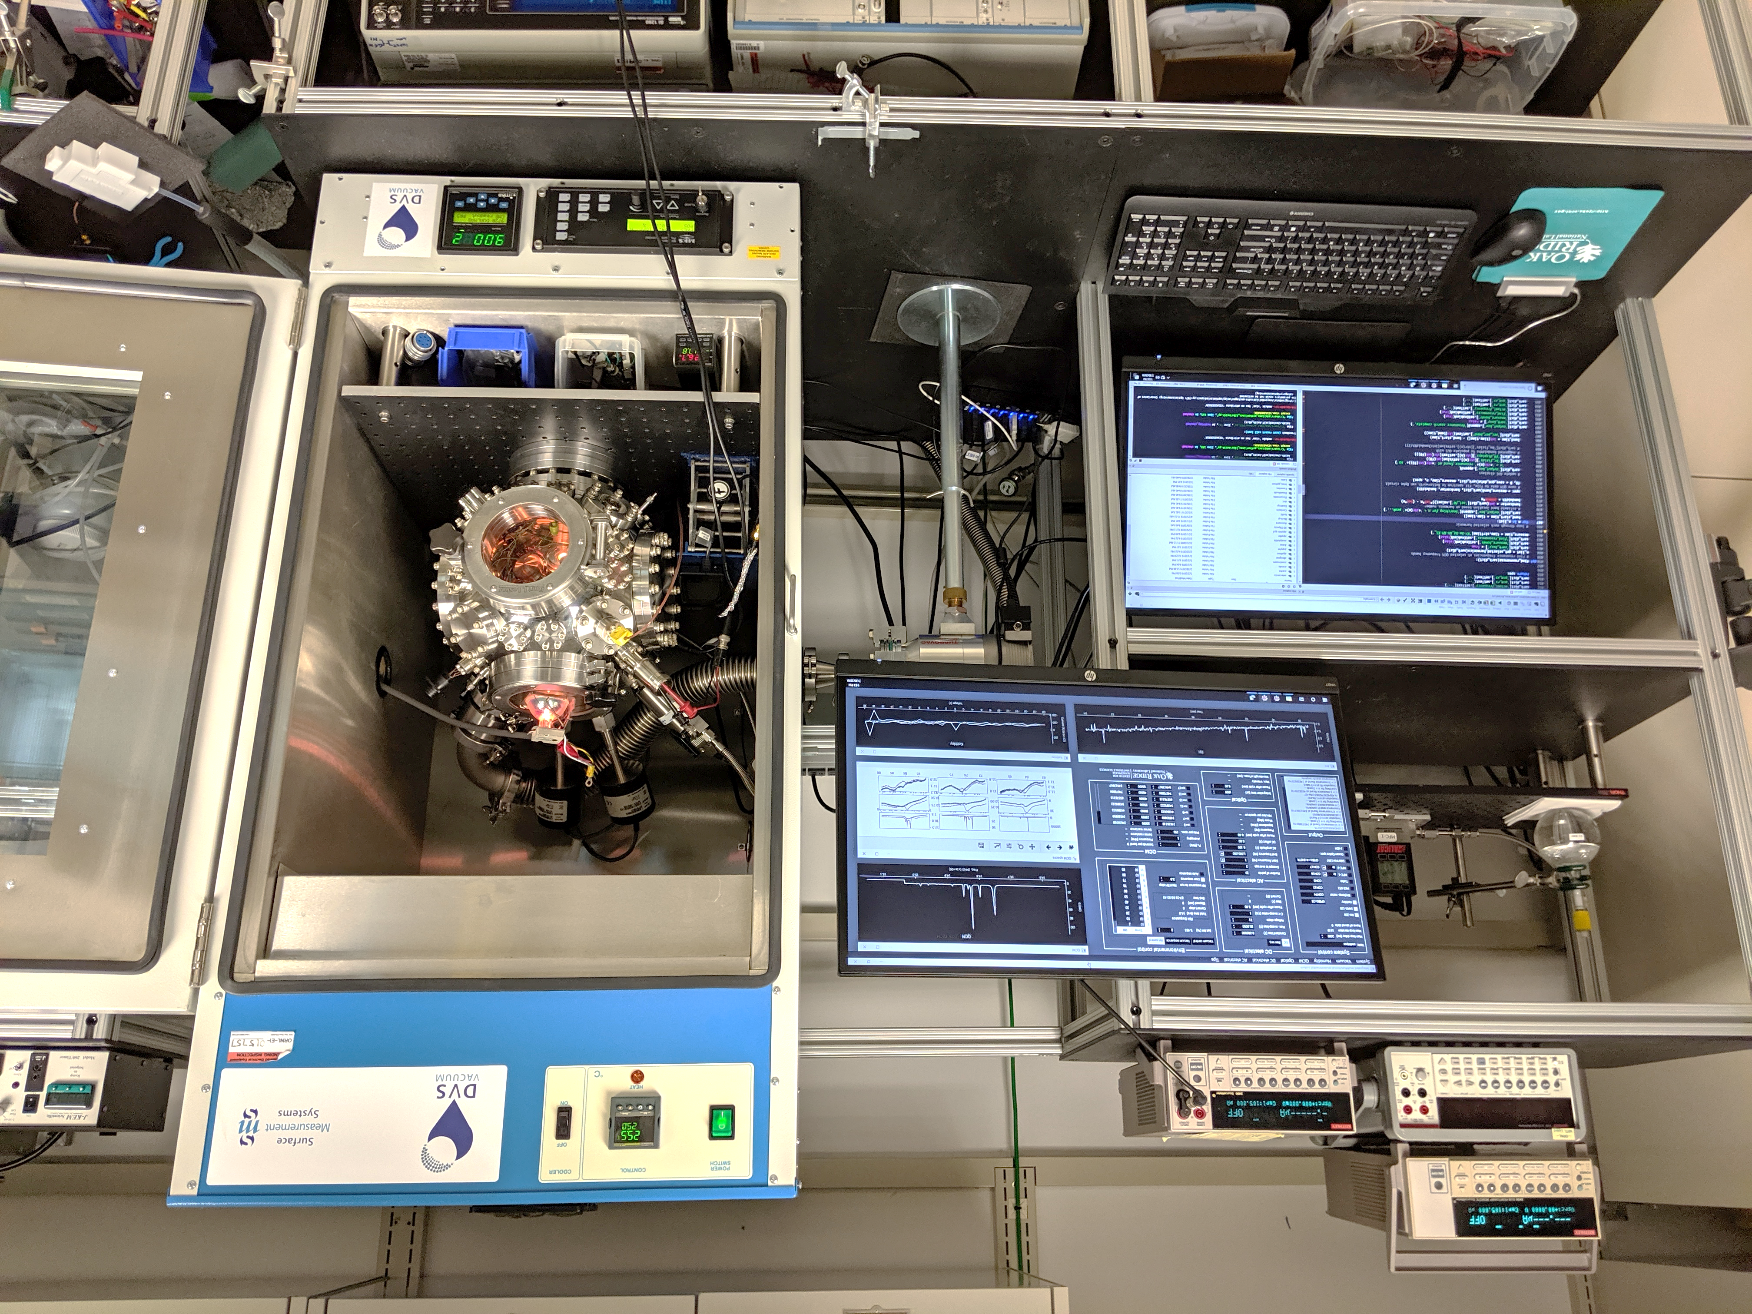

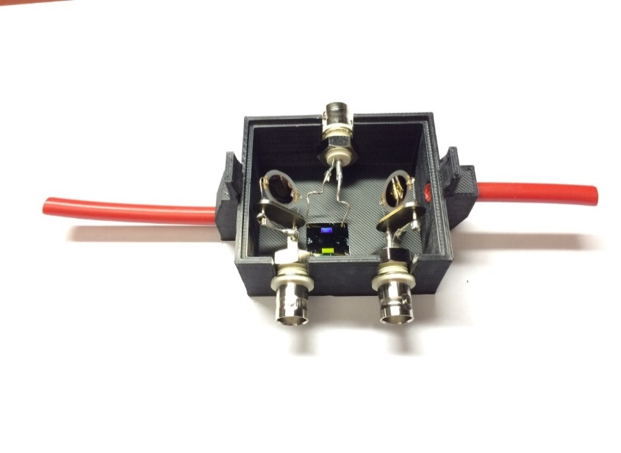
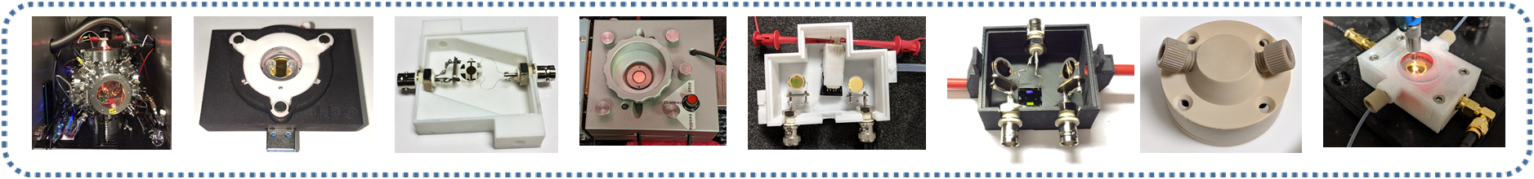
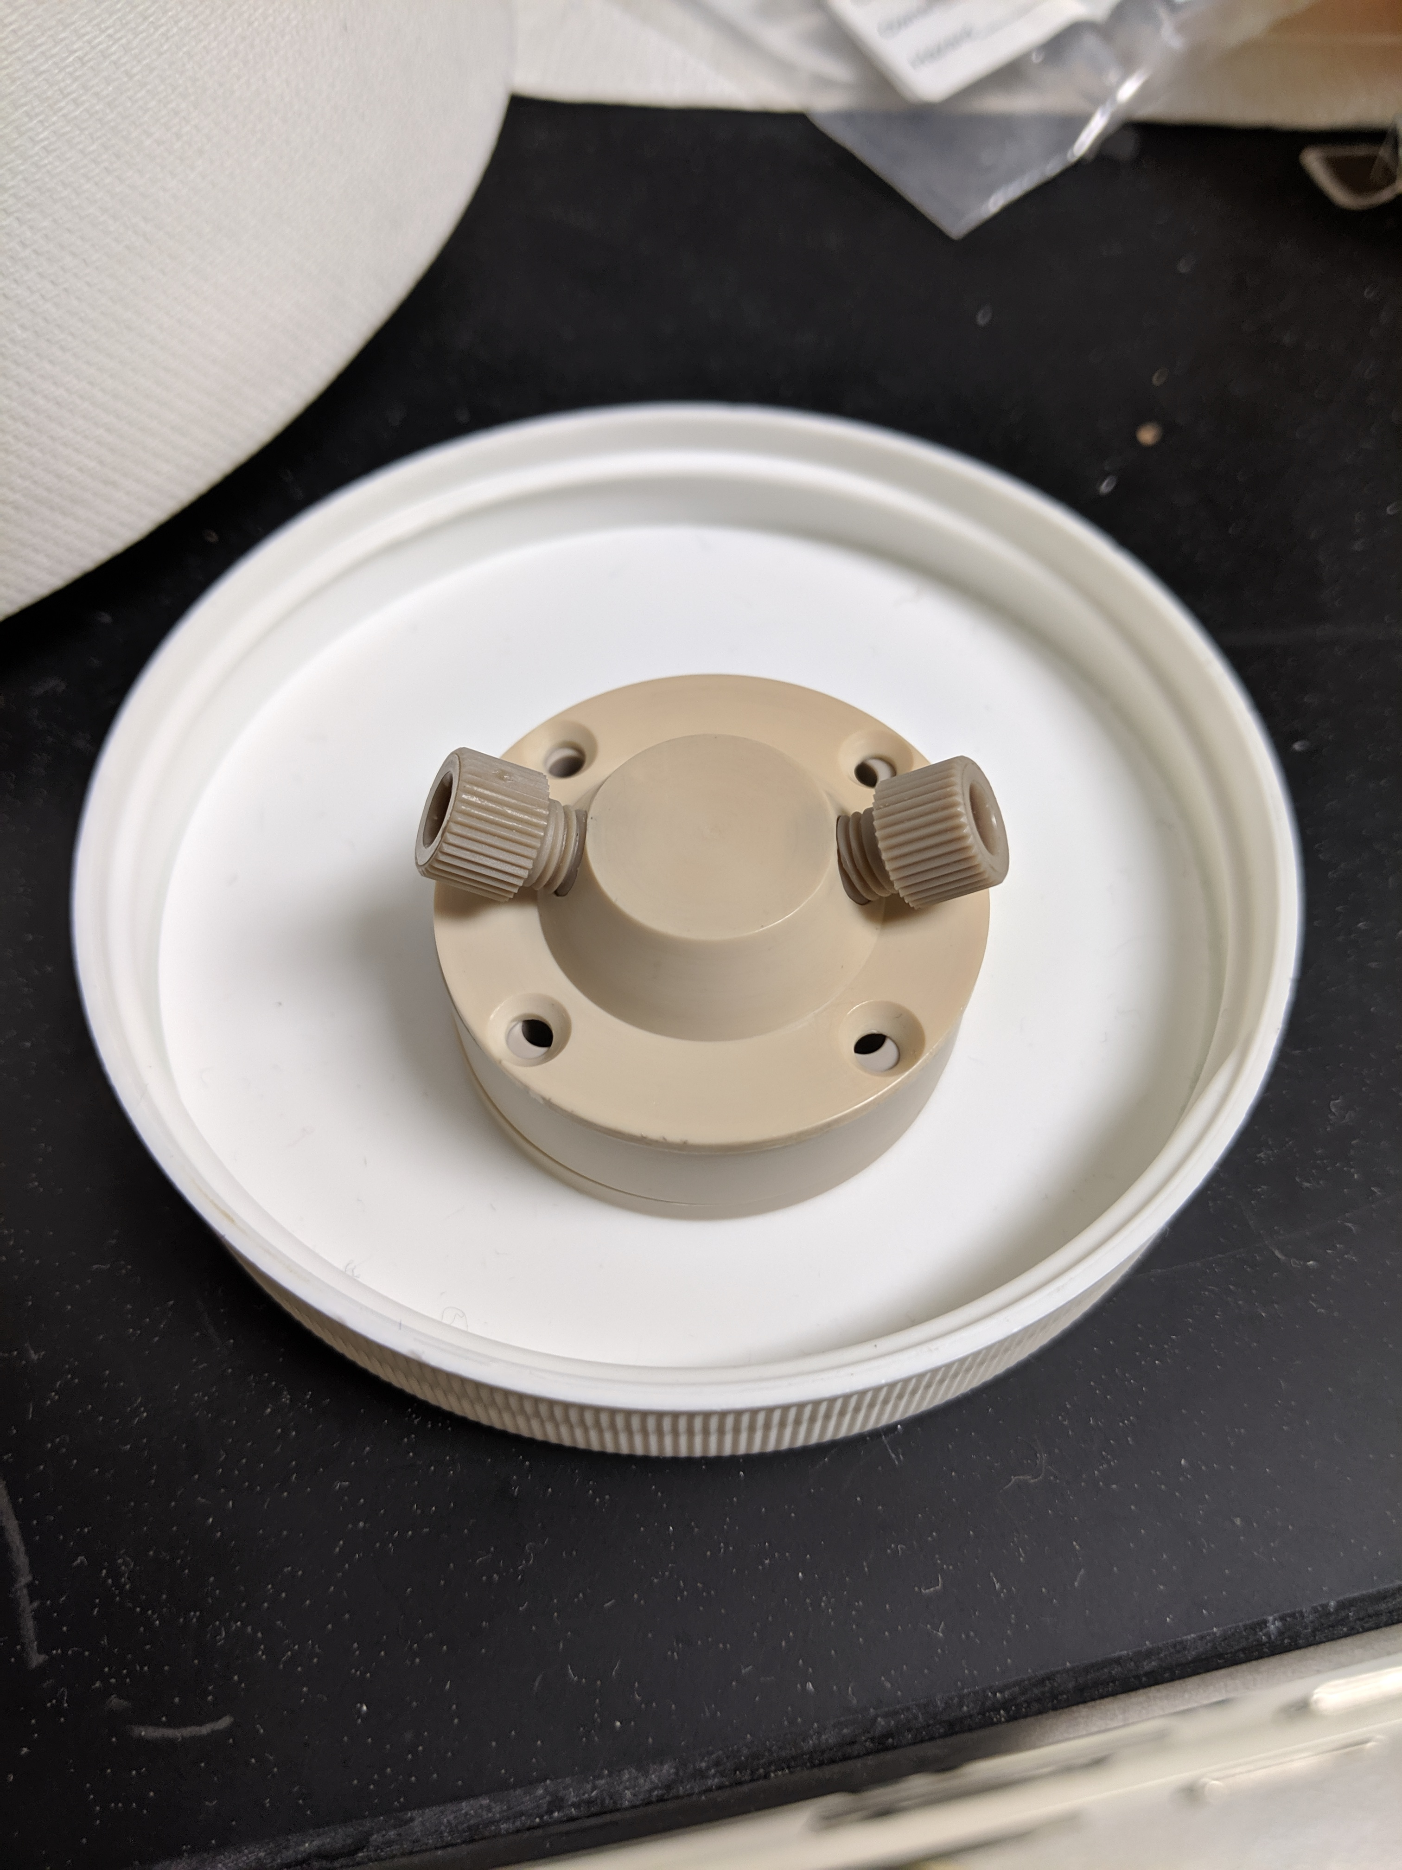
(a)
Electrical: 0 – 10 MHz
Gravimetric / viscoelastic: 5 – 100 MHz
Optical: THz
steady-state, ionic, dielectric
sorption kinetics, swelling
optical constants, vibrational, electronic
(b)
(c)
(d)
Control software
Feedback
Vacuum chamber
Environmental control
Sample
Optical spectrometer
Source-measure unit
Sample
Impedance analyzer
Sample
QCM controller
Sample

Slide 5
An extra blocks with the start of experiment are required, followed by selection of preset condition of user-defined for selected set of functionalities…
Start→ select functionalities/data streams →select instruments -→ program environmental steps→ set instruments (default) or user-defined.
User defined are shown in the flow chart
What’s data analytics behind “Material stabilized” decision, probably better signal stabilization?
Can it be done for all channels together for one channel or for selected data channels?
Please add arrow pointing the output of each data channel.
Currently they cycled within independent channel. At which point the software makes a decision → pass to modeling “update model” ?. Include autoML which was used in text, also python scripts.
Block ” Adjust sweep rate bias step size” is for I-V and C-V , but not for impedance.
Initialize experiment
Start software, choose directory for storing results
Select instruments
Select material functionalities/experiments
Select user-defined or automatic sequence
Electrical
Optical
Gravimetric/viscoelastic
Environmental
Design of experiment
Set bias range, step size, frequency range
Set wavelength range, integration time
Set frequency range, bandwidth, crystal harmonics
Set pressure, temperature, RH, gas/vapor flow
Data acquisition
Measure I-V, C-V, impedance
Measure spectra
Measure QCM conductance spectra
Maintain constant conditions
Real-time feedback
Adjust sweep rate, bias, step size, frequency range
Adjust wavelength range, integration time, fit parameters
Adjust frequency range, bandwidth, fit parameters
Select next condition based on material response or user-defined sequence
Calculate conductivity, capacitance
Calculate SNR, deconvolute and fit peaks
Deconvolute and fit peaks, calculate Δf, ΔD, viscoelastic properties
Material response has stabilized
Data analytics and modeling
True
False
Update model of multifunctional material response to environment (statistics, physical models, autoML regression)
Export data, export models, create publication-quality plots

Slide 6
Added real axes titles and units
(a)
(b)
(c)
(d)
(e)
(f)

Slide 7
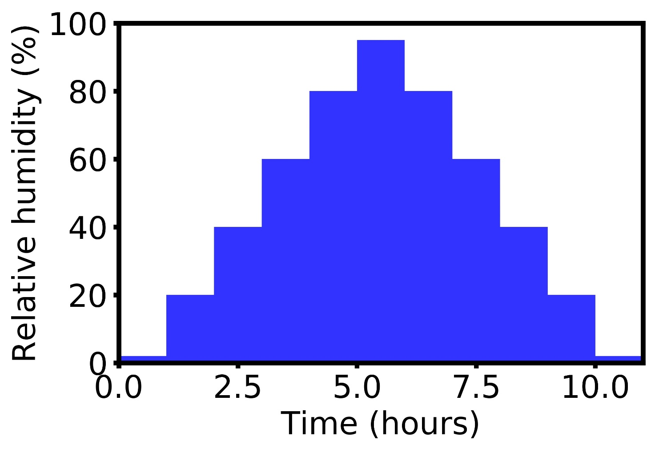
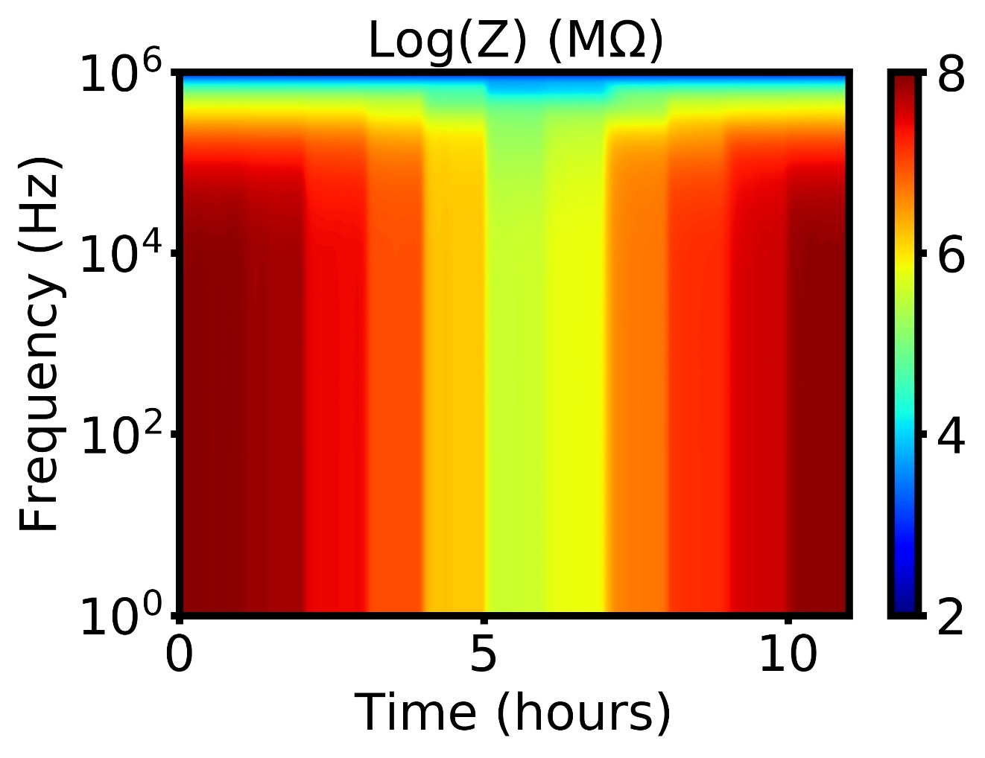
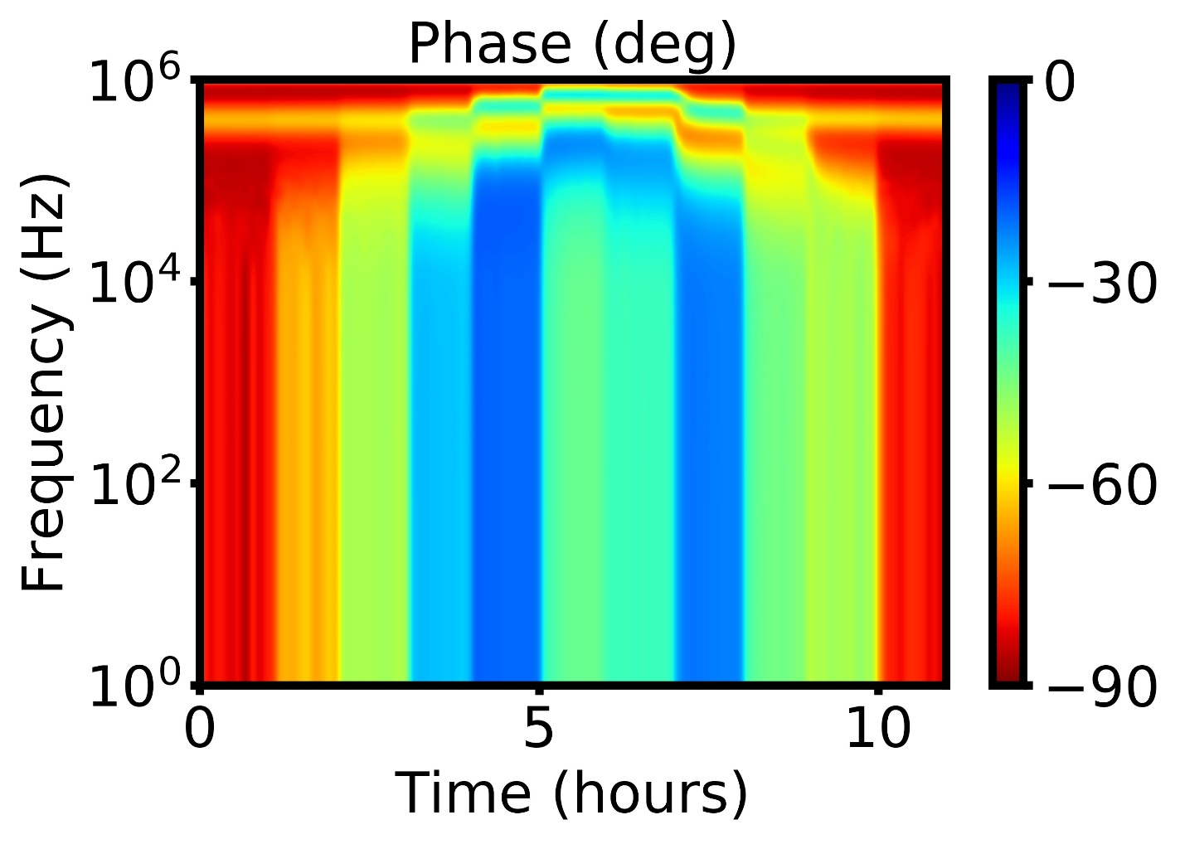
(a)
(b)
(c)
(d)

Slide 8
(a)
95%
2%
25 mV/s
50 mV/s
200 mV/s
(b)
(c)

Slide 10
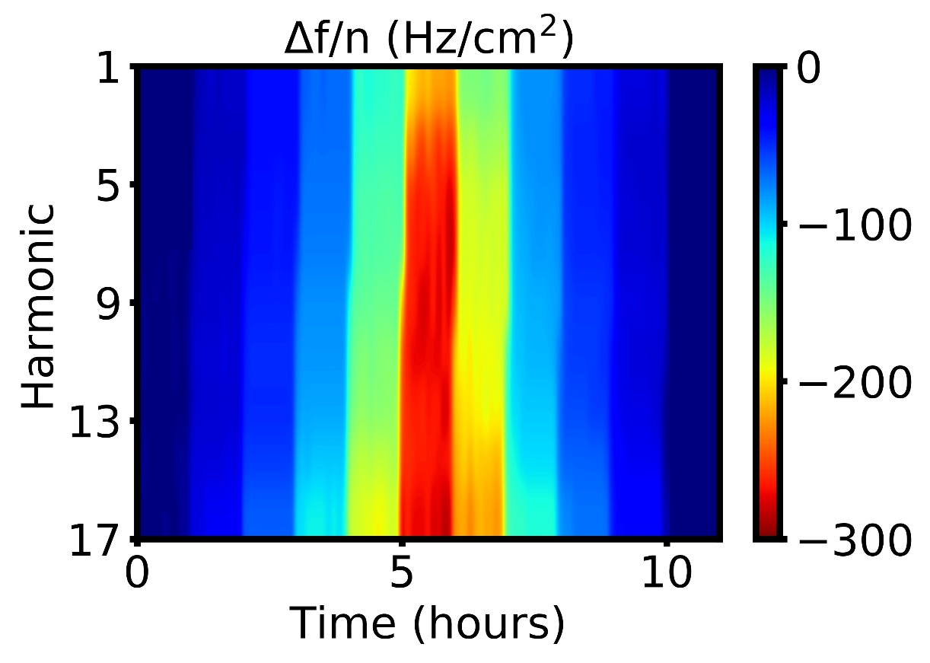
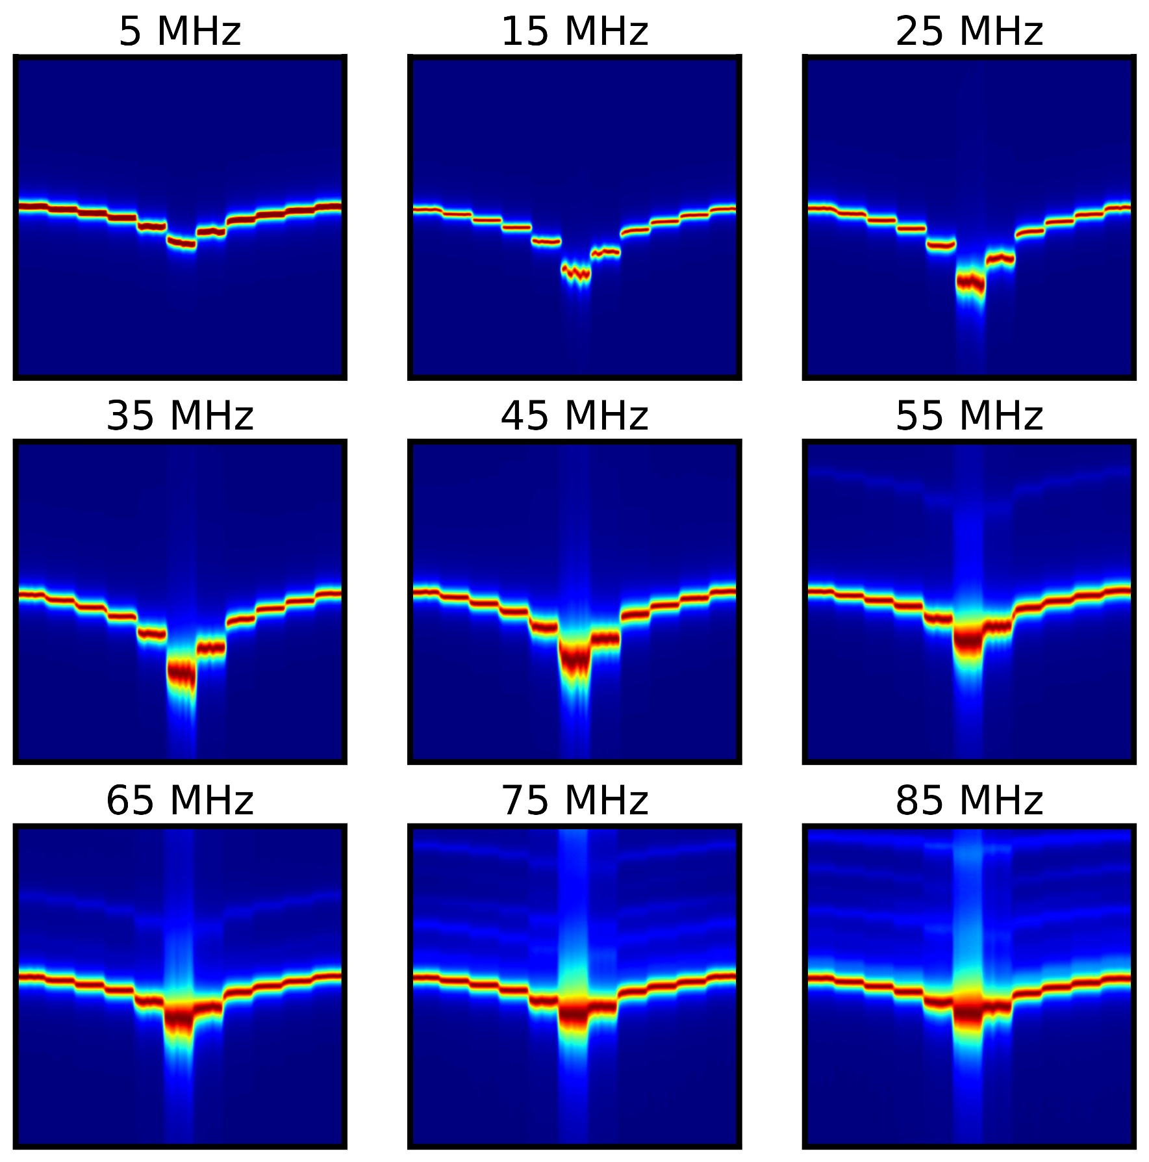
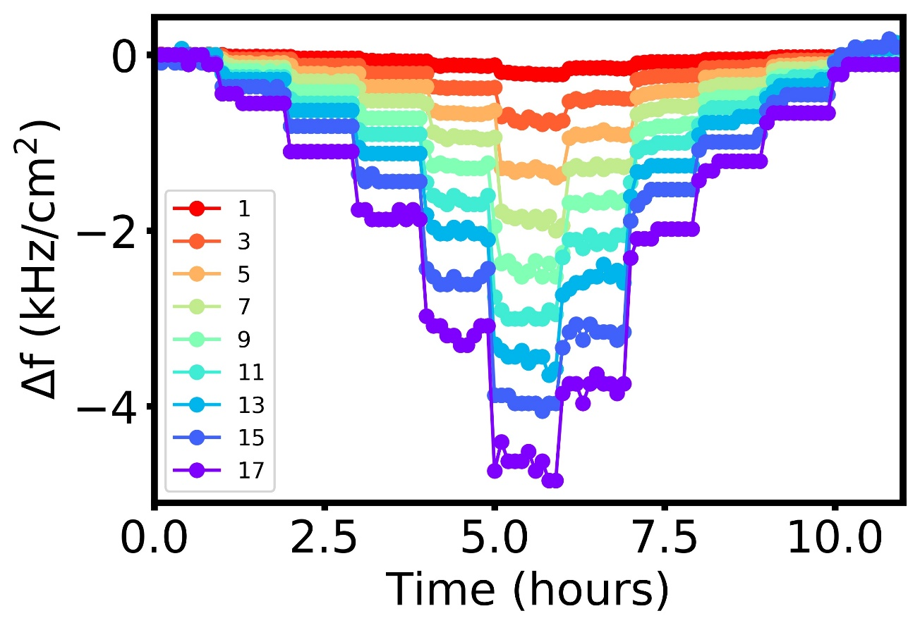

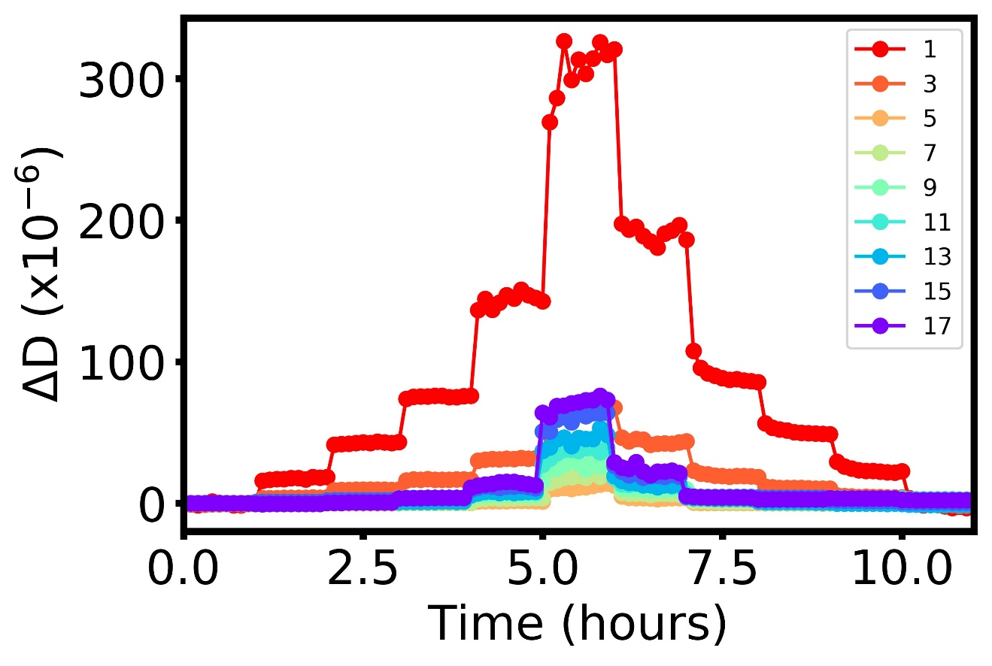
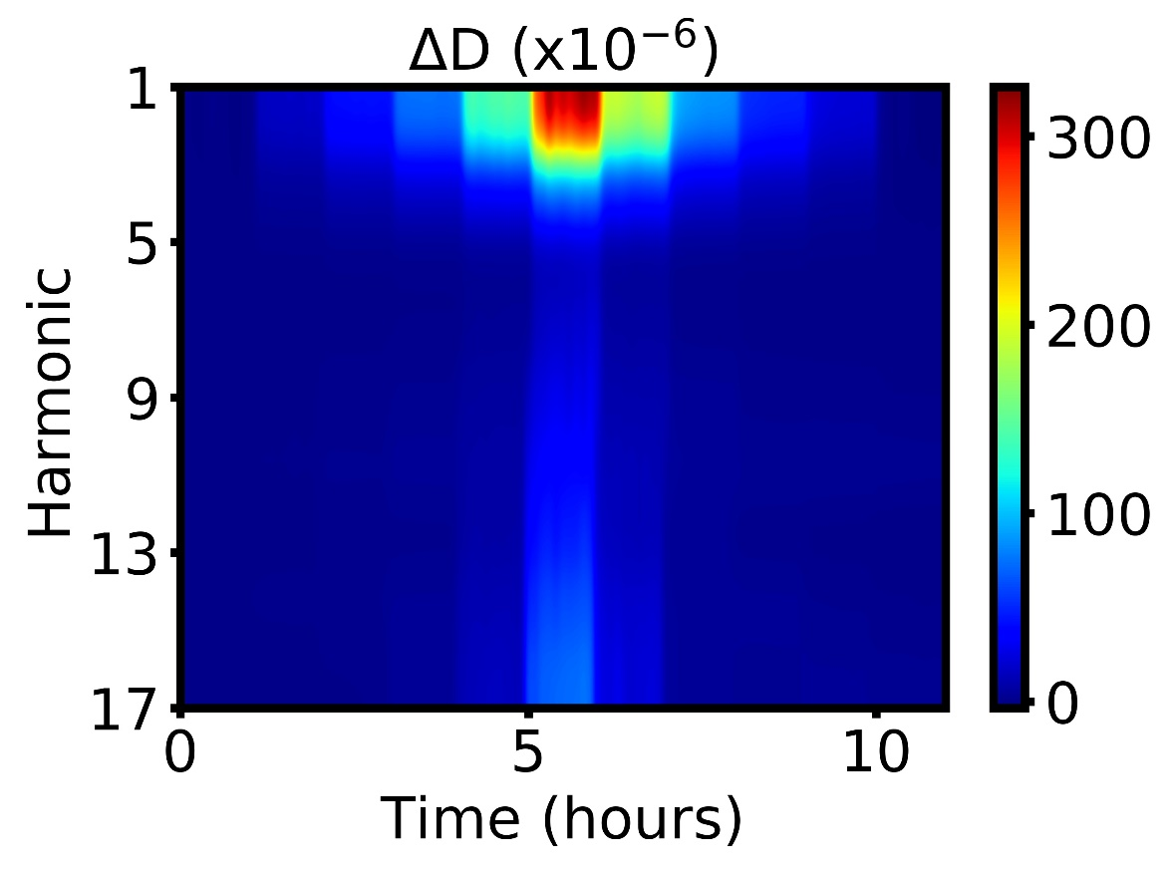
(b)
(e)
(a)
(c)
(d)

Slide 11
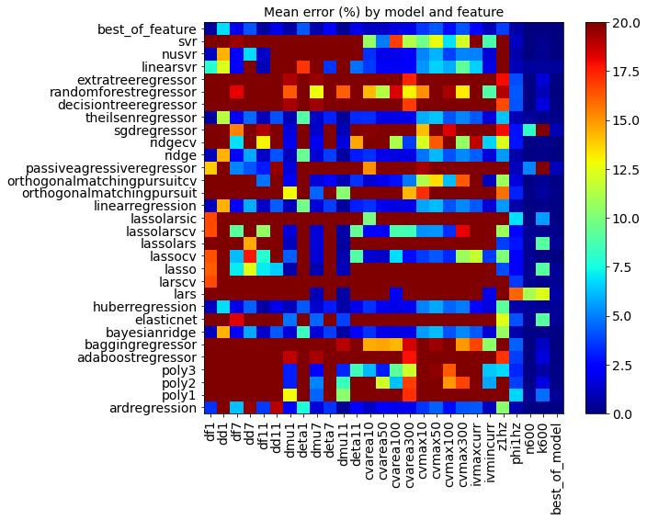

Slide 12
UNUSED / SUPPLEMENTAL FIGURES

Slide 13
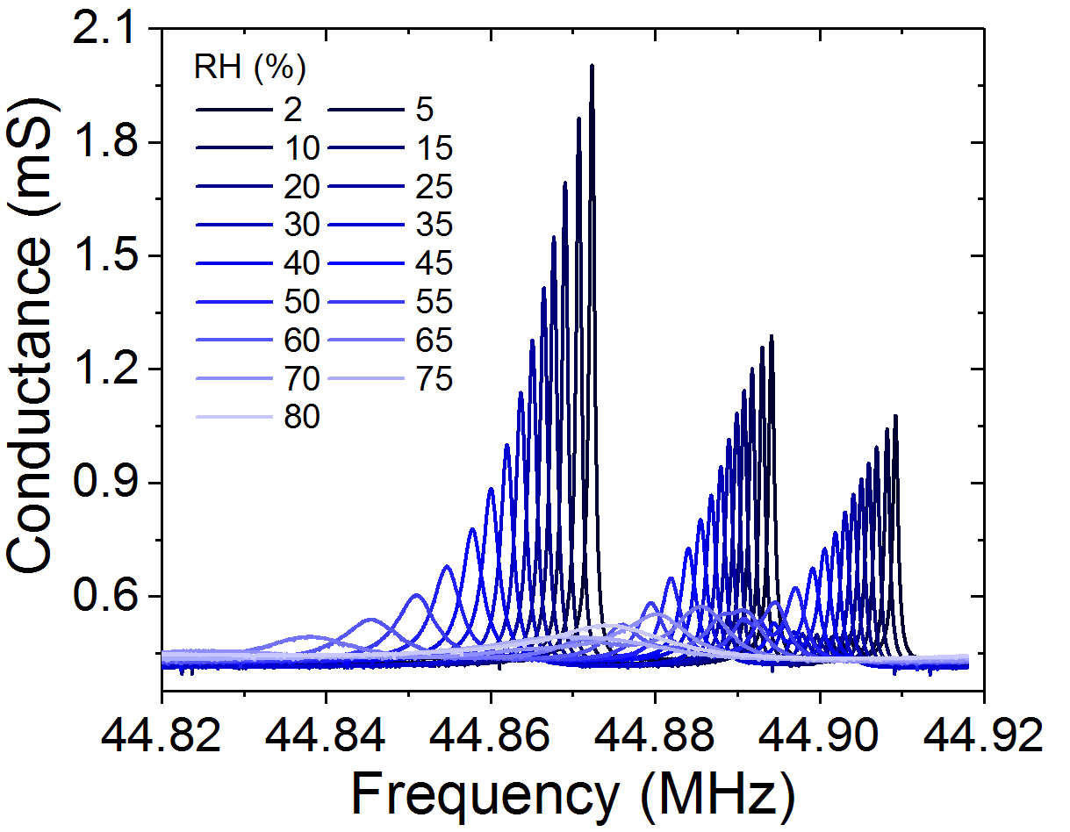
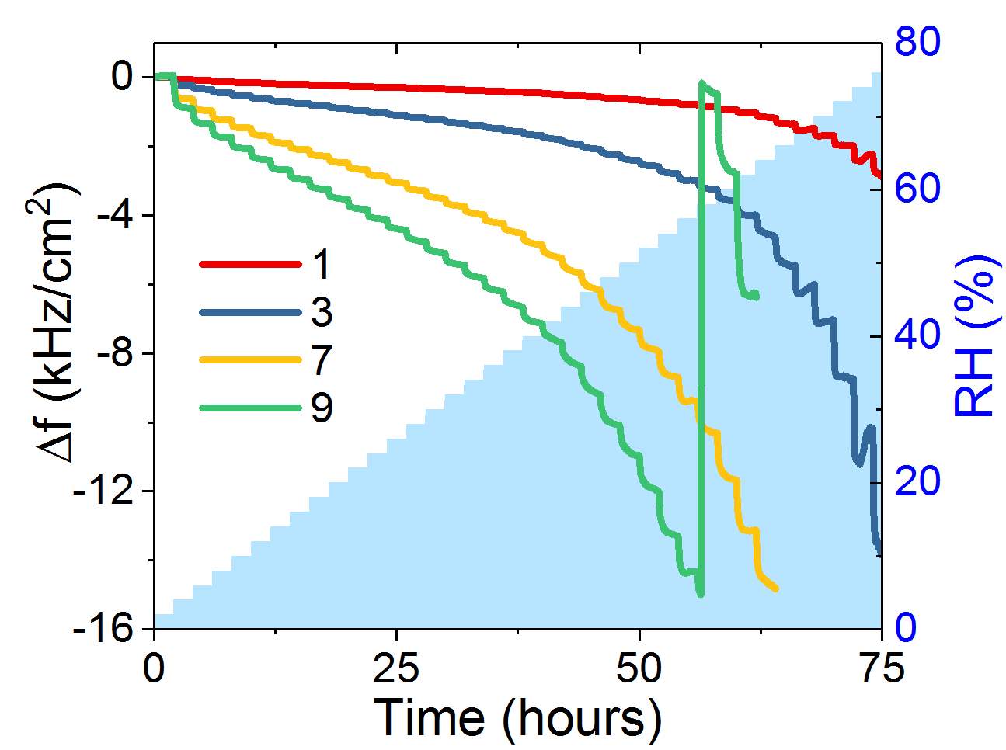
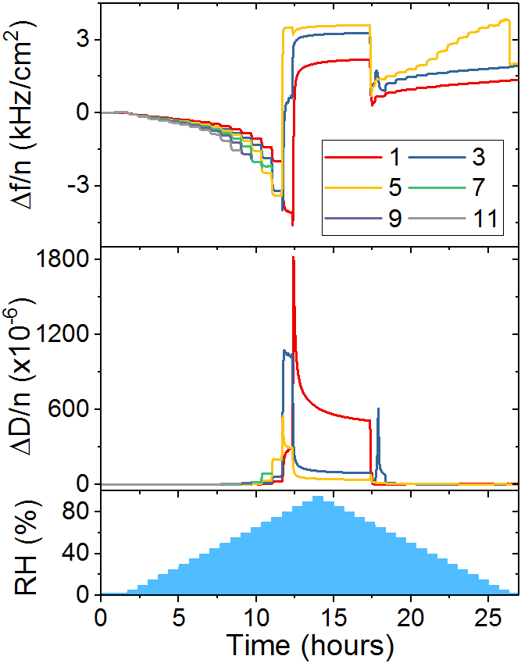
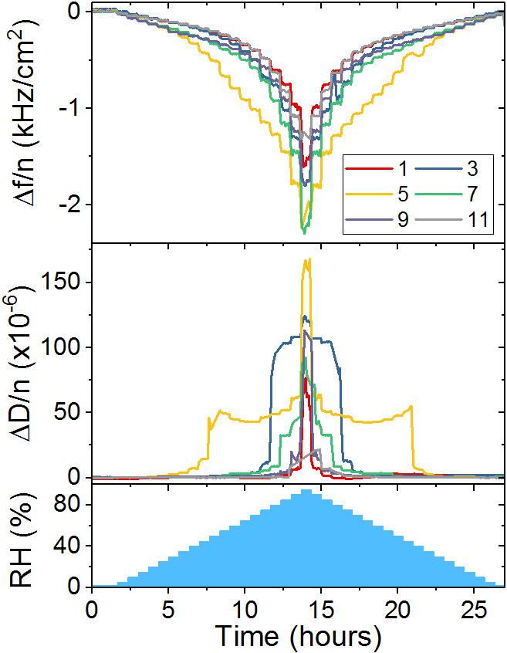
(a)
resonance
(b)
spur
spur
(c)
(d)

Slide 14
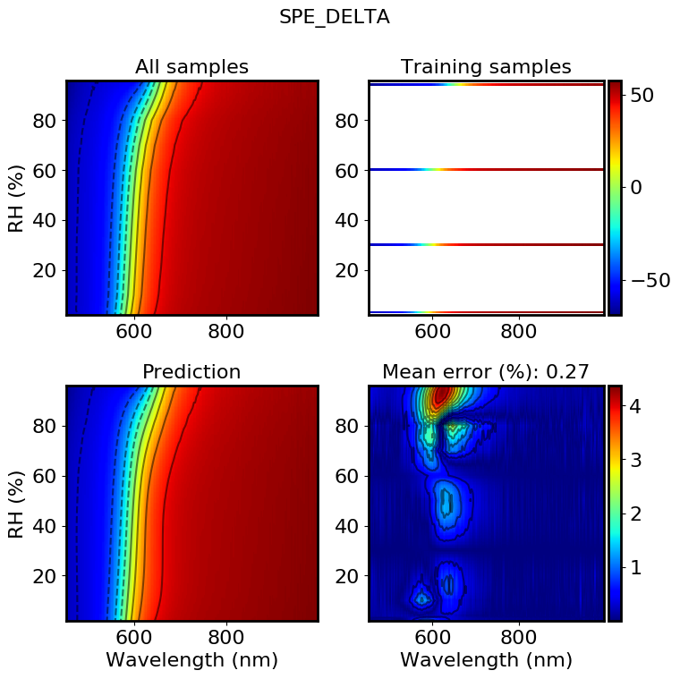
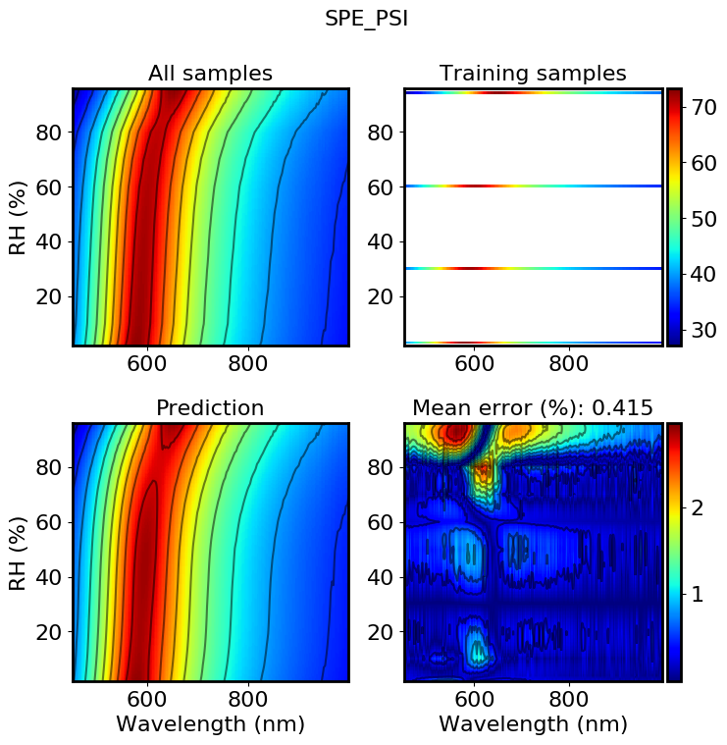
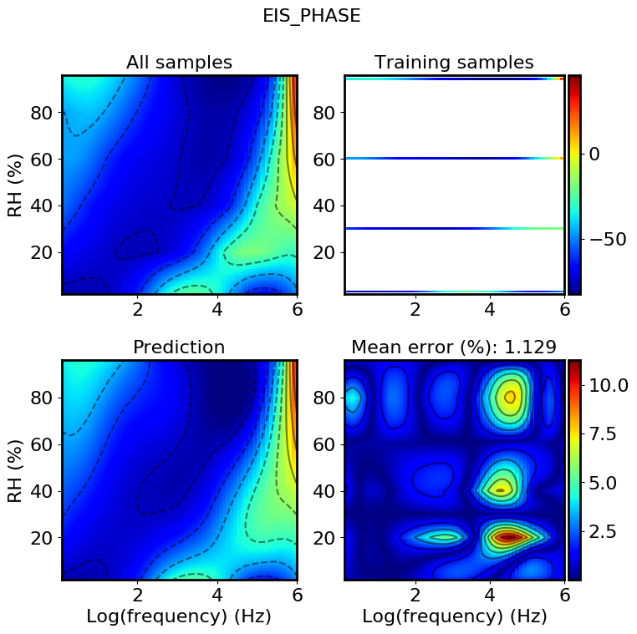

Slide 15

(a)
(b)
(c)
(d)

Slide 16
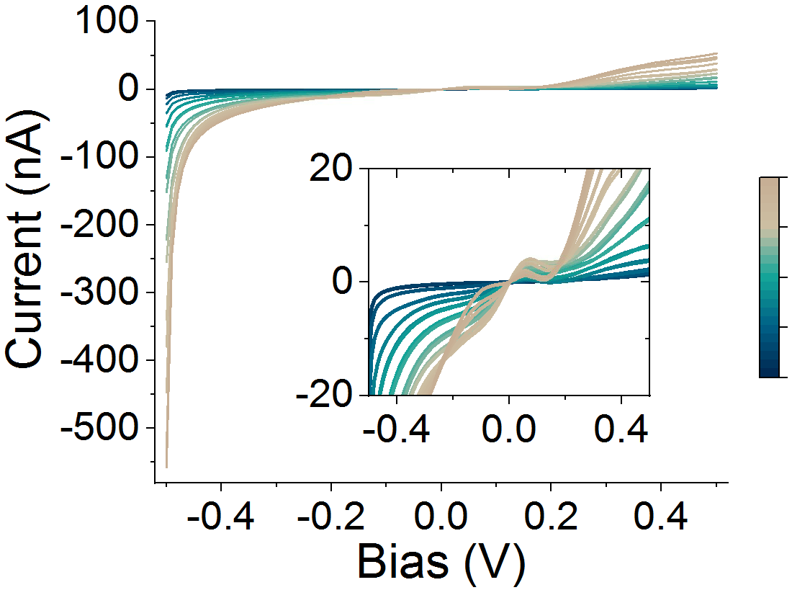
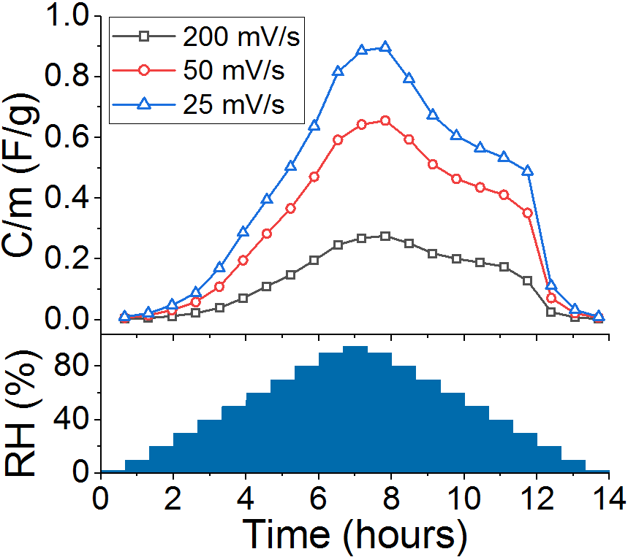
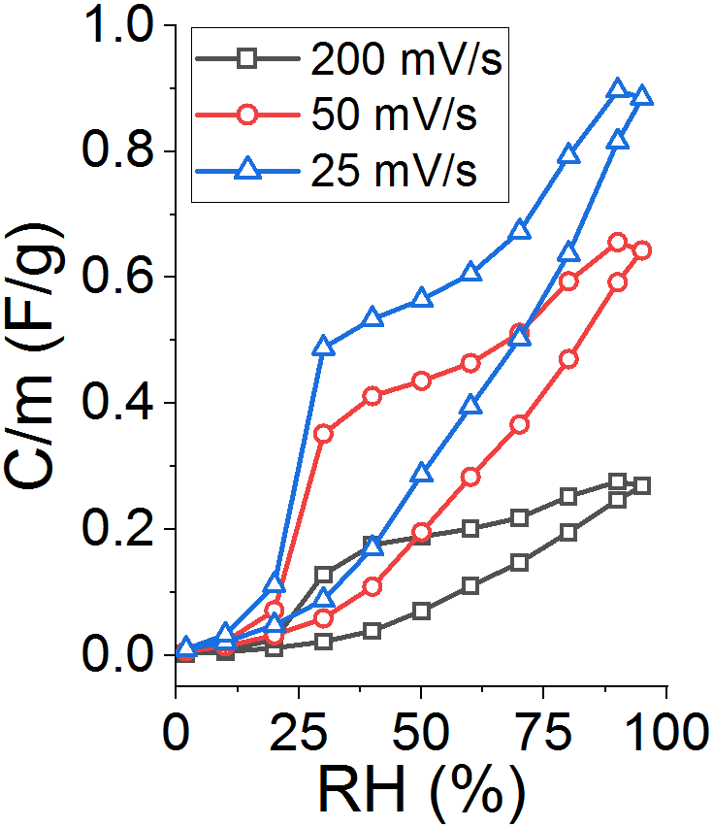
(a)
RH (%)
95
75
50
25
25 mV/s
50 mV/s
200 mV/s
2
(b)
(c)

Slide 17
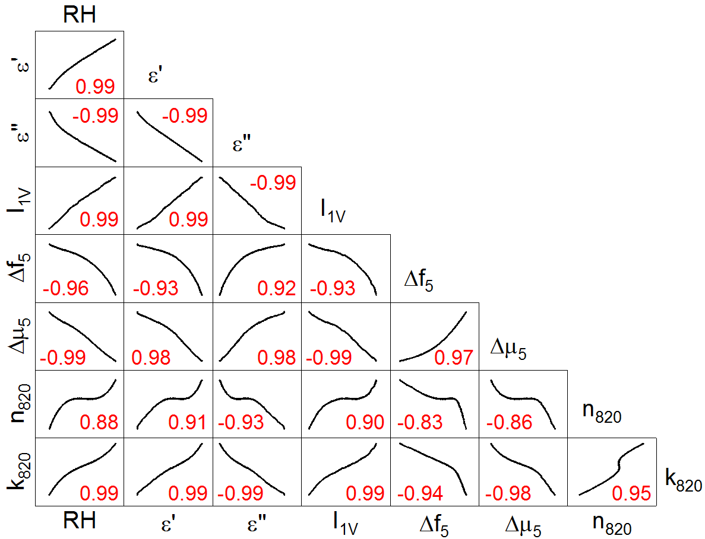
real dielectric constant
AC electrical
imaginary dielectric constant
current @ +1V bias
DC electrical
freq. shift @ 5th overtone
Gravimetric/ viscoelastic
shear modulus @ 5th overtone
index of refraction @ 820 nm
Optical
extinction coef. @ 820 nm

Slide 18
relative humidity
real dielectric constant
AC electrical
imaginary dielectric constant
current @ +1V bias
DC electrical
freq. shift @ 5th overtone
Gravimetric/ viscoelastic
shear modulus @ 5th overtone
index of refraction @ 820 nm
Optical
extinction coef. @ 820 nm

Slide 19
Electrical
Optical
Gravimetric/viscoelastic
Environmental
Design of experiment
Set bias range, step size, frequency range
Set wavelength range, integration time
Set frequency range, bandwidth, crystal harmonics
Set pressure, temperature, RH, gas/vapor flow
Data acquisition
Measure I-V, C-V, impedance
Measure spectra
Measure QCM conductance spectra
Maintain constant conditions
Real-time feedback
Adjust sweep rate, bias, step size
Adjust wavelength range, integration time, fit parameters
Adjust frequency range, bandwidth, fit parameters
Select next condition based on material response
Data analytics and modeling
Calculate SNR, deconvolute and fit peaks
Deconvolute and fit peaks, calculate Δf, ΔD, viscoelastic properties
Material stabilized
Calculate conductivity, capacitance
True
False
Update model of multifunctional material response to environment
Export model, publication-quality plots

Slide 20
(a)
(b)
(c)
(d)
(e)
(f)

Slide 21
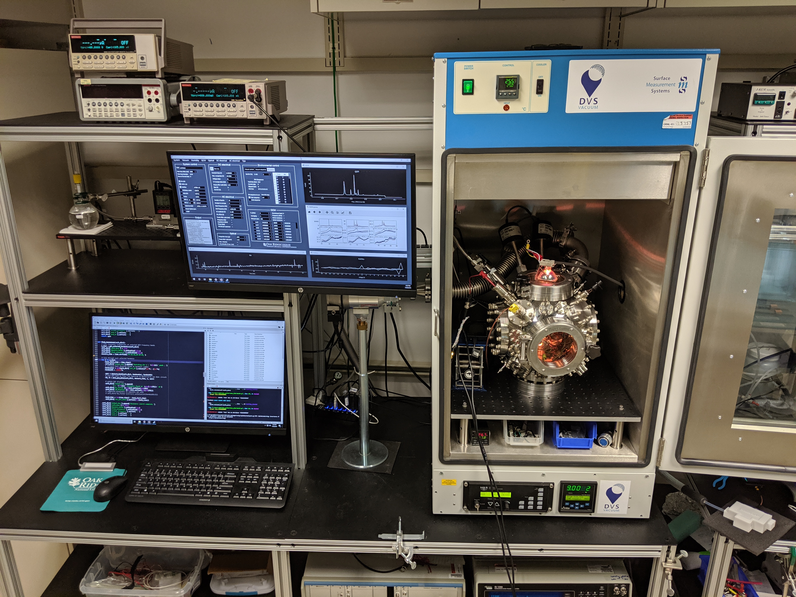
(a)
Electrical
Gravimetric / viscoelastic
Optical
steady-state / ionic
dielectric
sorption kinetics
swelling
optical constants
vibrational
electronic
Hz
MHz
THz
(b)
Control software
Feedback
(c)
Vacuum chamber
Environmental control
Sample
Optical spectrometer
Source-measure unit
Sample
Impedance analyzer
Sample
QCM controller
Sample

